Slide 1
Multi-Agent LLMs Wine Explorer
By: Darrel Wu, Sen Yang, Vicky Li,
Cocoon Cao
Notes:
We will be talking about our product proposal of

Slide 2
TABLE OF CONTENTS
01
Business Problem
04
Solution Impact
02
Technical Overview
05
Conclusion
03
Demo

Slide 3
Business Problem
Solution
For Wine Beginner/Enthusiasts
Find the best wine
Learn about the wine
Share with your friends
Semantic Search
AI Agents
Notes:
I want you to imagine walking into a wine store or browsing online, where you're confronted with thousands of bottles, each with a different price, flavor profile, and food pairing suggestion. Whether you're a wine novice or an expert, finding the right bottle for a special occasion, a gift, or even just a casual dinner can be overwhelming. Traditional recommendation systems typically rely on filters for basic attributes like price, origin, or variety. However, they often miss the nuances of individual preferences, such as flavor profiles or specific pairing needs. This can make the wine-buying experience confusing, time-consuming, and frustrating.
Our tool takes the guesswork out of wine selection by leveraging an advanced LLM (Large Language Model) to provide personalized wine recommendations, tailored specifically to your taste preferences and budget. Whether you're looking for the perfect wine to impress your dinner guests or just a casual wine for a quiet evening, this helps you navigate the sea of options with ease. By using sophisticated AI techniques like retrieval-augmented generation (RAG) systems and semantic search, we analyze thousands of reviews, ratings, and even pricing data to give you the best, most relevant wine suggestions in real-time. Our approach is built on two Semantic Search, and AI Agents, all of which work together to offer a truly personalized and dynamic experience.
Next, we implement Semantic Search, which allows the model to understand the meaning behind your query with cosine similarity. Instead of just matching keywords, our system interprets the intent and context of what you're asking But what truly sets this platform apart is our use of AI Agents. These agents don’t just recommend wines; they go further by gathering additional insights from platforms like YouTube. The agents can scrape educational videos, expert reviews, and pairing suggestions from reliable sources, giving users a deeper understanding of why a particular wine is recommended and how to best enjoy it. Whether it's sourcing expert opinions or suggesting unique pairings, these AI agents enrich the experience, ensuring that users are not only making a choice but also learning more about their selection.
By combining these two pillars, our platform delivers more than just a wine recommendation—it provides a complete wine story, including notes, pairings, and expert insight, tailored specifically to the user’s taste and needs.

Slide 4
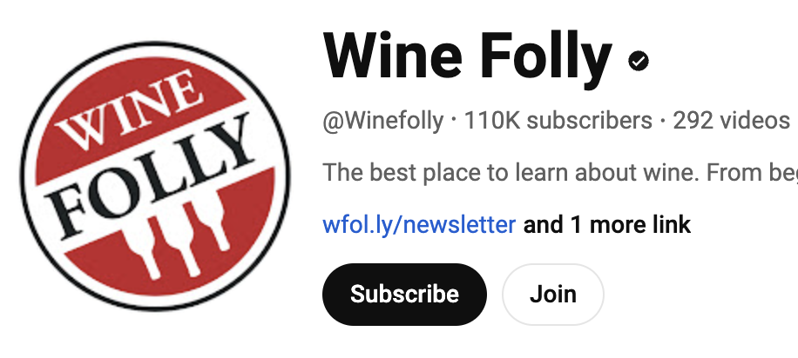
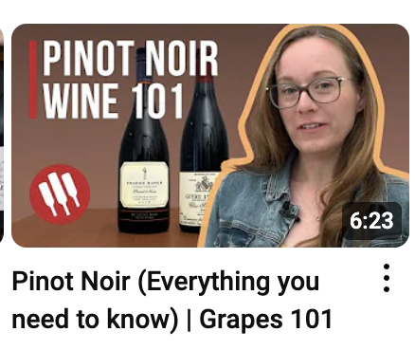
Technical Overview - Workflow
Multi-Agent LLMs
User
Agent 1
A list of best matching wines
“Wine Preference”
Wine Search Engine
Task: Search and recommend top 3 wines
Agent 2
Task: Find relevant video about the best wine and generate transcription
Video Analyst
Video transcription
Agent 3
Agent 4
Wine Expert
Social Media Post Writer
Task: Introduce the wine from the transcription
Task: Write a post from the transcription

Slide 5
Technical Overview - Agent 1
Text Data Preparation and Embedding:
TextLoader
CharacterTextSplitter
OpenAIEmbeddings
Vector Storage and Indexing:
Faiss-gpu
Model Chaining for Query Processing:
LLMChain
Rank | Wine | Descriptions
1 | Cabernet Sauvignon |  | xxx
2 | Merlot |  | xxx
3 | Airén |  | xxx
Expected Value

Slide 6
Technical Overview - Agents 2
Agent 2
Searches and generate transcriptions from YouTube videos:
Youtube-transcript-api
Yt_dlp
Expected Value
Video Analyst
# Agent: Topic Researcher
## Task: Identify and analyze videos on the topic Cabernet Sauvignon from YouTube channel.
## Thought: Obtain a detailed report on XX.
## Using tool: Search a Youtube Channels
## Tool Input:
"{\"search_query\": \"Give an introduction of Cabernet Sauvignon\"}"
## Tool Output:
Relevant Content:
@Winefolly
@Winefolly
Technology
Youtube search
Youtube-transcript-api
Yt_dlp
YoutubeChannelSearchTool
AI Agent
crewai
OPENAI API

Slide 7
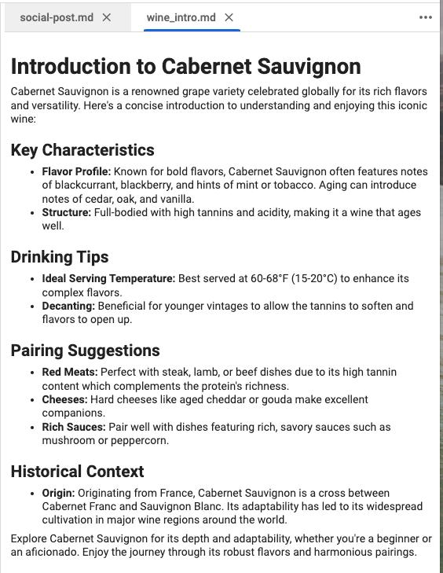
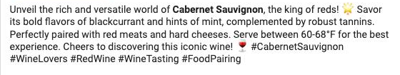
Technical Overview - Agents 3-4
Expected Value
Introduction to Pinot Noir
Pinot Noir is a refined red grape from Burgundy, France xxx.
Key Characteristics
xxx
Drinking Tips
Best served chilled at 55-60°F
Pairings Suggestions:
Salmon: xxx
Agent 3
Wine Expert
Multi-agent to automate workflow
crewai
Process transcriptions and generate content:
gpt-4o
Agent 4
"🍷 Discover the elegance of Pinot Noir! This delicate red wine from France, xxx. Best enjoyed slightly chilled at 55-60°F xxx 🧀🍇 #wine #pinotnoir #xxx ”
Social Media Post Writer

Slide 8
Demo
Ask about wine
I want to try red wine from France
Recommend a fruity wine
What wine pairs well with seafood

Slide 9
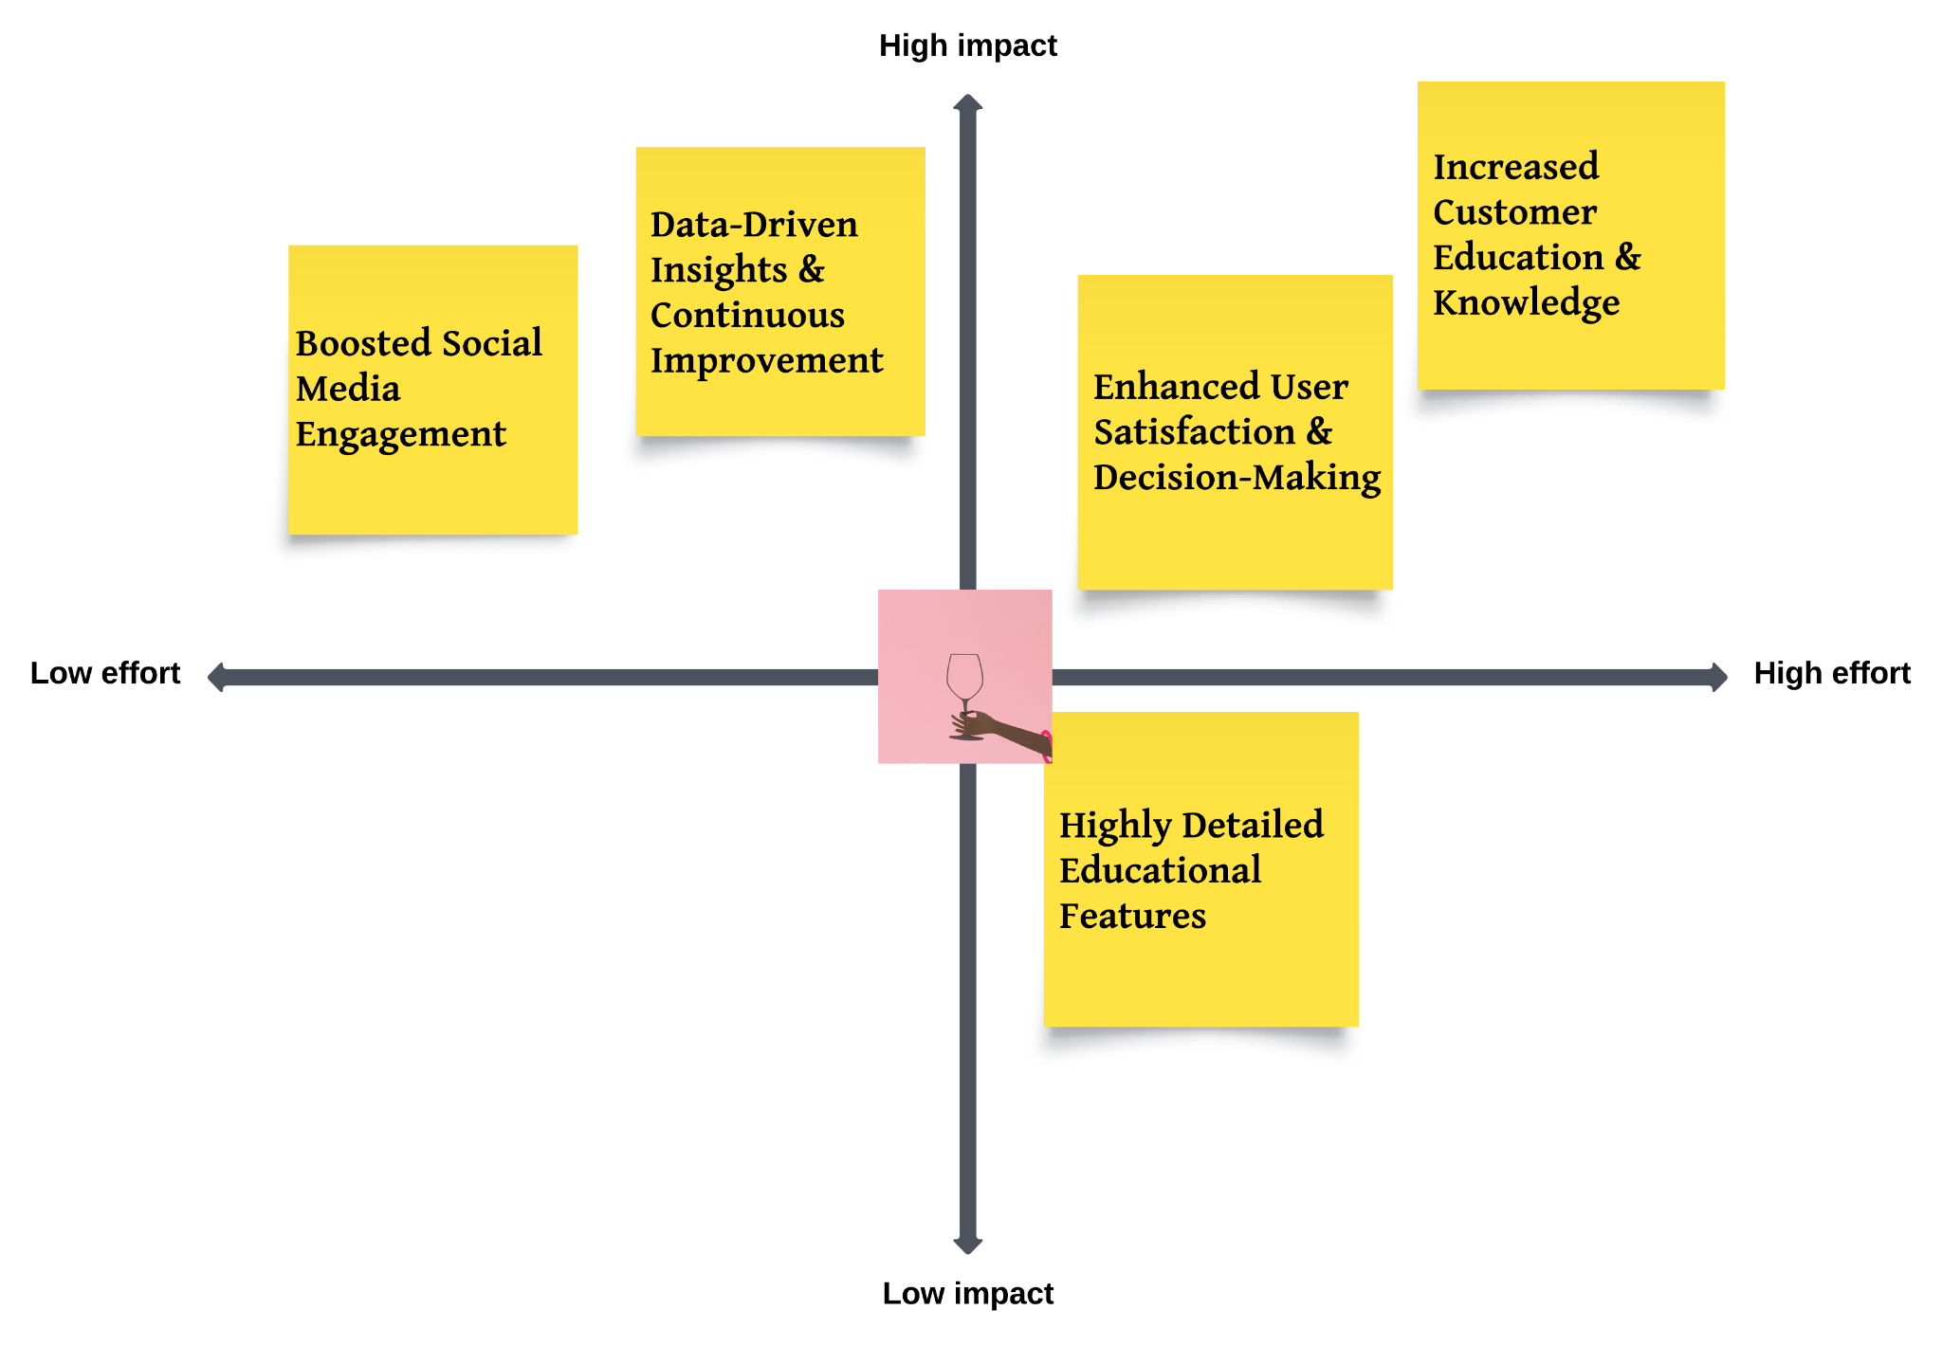
Potential Impacts
Notes:
Boosted Social Media Engagement: By using AI to automate social media content, we can quickly tap into organic marketing. Once set up, it runs with minimal effort but drives high engagement as users share wine recommendations, boosting brand visibility and traffic without much manual work.
Data-Driven Insights & Continuous Improvement: Analytics tools track user preferences, offering ongoing data that helps refine recommendations. This low-cost solution keeps the system relevant by adapting to user behavior, making it a powerful tool for long-term success.
Enhanced User Satisfaction: While building a recommendation system with AI and semantic search requires investment, it results in highly personalized experiences that reduce decision-making for users, increasing satisfaction and retention.
Customer Education: By integrating educational content from YouTube and experts, we help users learn more about wines, creating a loyal customer base that values both recommendations and learning opportunities.
Scalable Educational Features: While detailed educational content is valuable, focusing on high-impact, easily scalable information is key. Granular topics or extensive video production may not appeal to a broad audience or offer a strong ROI.

Slide 10
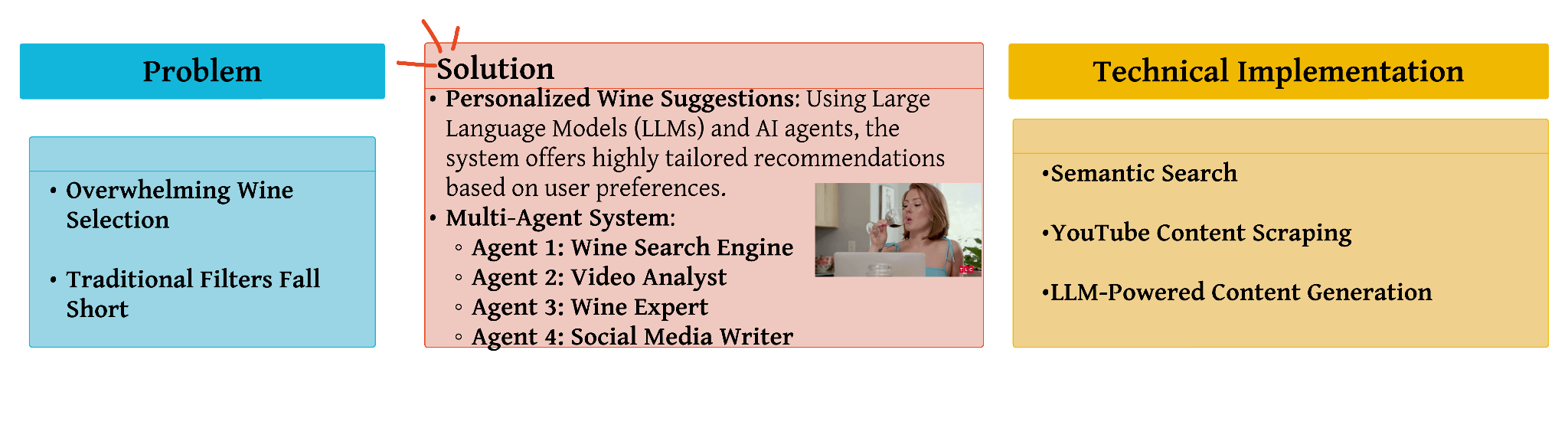
Conclusion
Notes:
The solution addresses the overwhelming choice of wines by leveraging AI-powered personalization. Using a multi-agent system, it tailors recommendations to individual preferences, going beyond traditional filters like price or origin. The system integrates semantic search to match user queries with wine options, scrapes expert reviews from YouTube, provides detailed insights on wine characteristics and pairings, and generates social media content for easy sharing. This approach combines large language models (LLMs) with real-time data gathering to offer a seamless, personalized wine selection experience that considers both user tastes and expert knowledge.

Slide 11
THANKS!
Q&A
By: Darrel Wu, Sen Yang, Vicky Li,
Cocoon Cao

